Slide 1

By :
Meryem Ben Salem
Cherifa Chaouch
2024/2025

Slide 2

Agenda
CRISP-DM overview.
Data collection and Scraping process.
Data cleaning and preparation.
Modeling and evaluation.
Results and next steps.

Slide 3
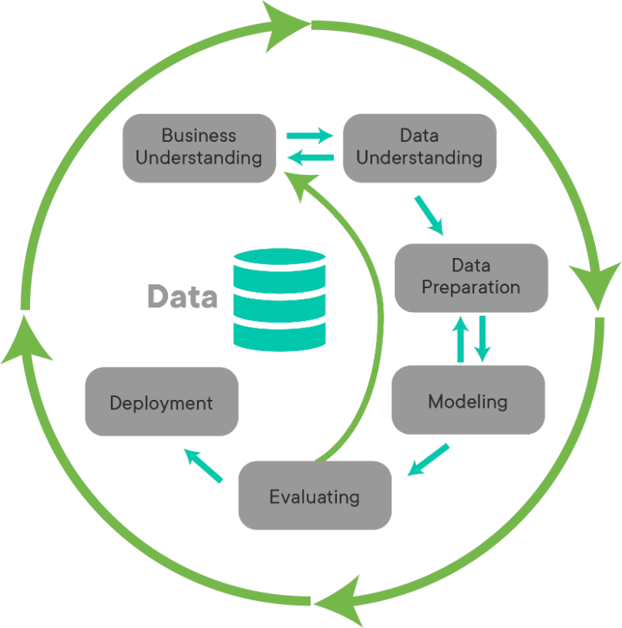
Overview of CRISP-DM
Industry-standard approach for data mining and machine learning projects.
Provides a structured, repeatable process for problem-solving.

Slide 4



Business Understanding
Problem Statement:
Key Business Questions:
Business Goals:
"What are the key factors that influence property prices?"
"Real estate prices in Tunisia vary greatly depending on factors such as location and property size. "
"The project aims to assist property buyers, sellers, and investors in Tunisia by providing accurate property price estimates based on historical data."
"Can machine learning models predict property prices with high accuracy?"

Slide 5



Data Preparation :
Collecting DataHub
Exploratory Data Analysis (EDA)
Data Cleaning and Processing
Scraping TAYARA.TN with Selenuim
Handling Missing Values
Checking for duplicates
The Data is highly skewed : Presence of Outliers .
Store the extracted data in CSV file
Handling Outliers
No normal Distribution .
Feature Engineering

Slide 6

Data Collection
Data Source:
scraped TAYARA.TN using Python and Selenuim , gathering information on property features such as:
location, size, number of rooms, batrooms , category , transaction type and price.
We scraped around 800 Property Ad by region so that we have a Balanced Data .
The dataset contains over 20,138 property listings .

Slide 7
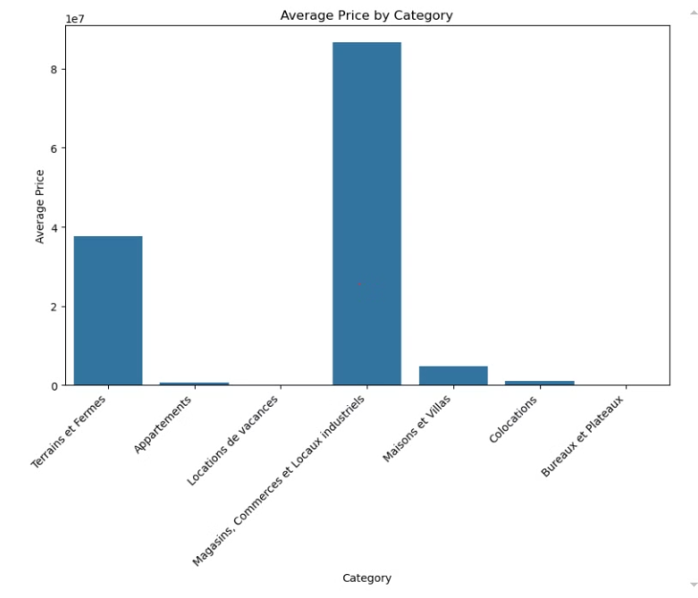
Exploratory Data Analysis (EDA)
Price Distribution by Category: Showed the skewness before transformation.
Plot histograms for relevant features in the dataset
Correlation Matrix: Showed the relationship between features like price, bedrooms, and bathrooms.

Slide 8
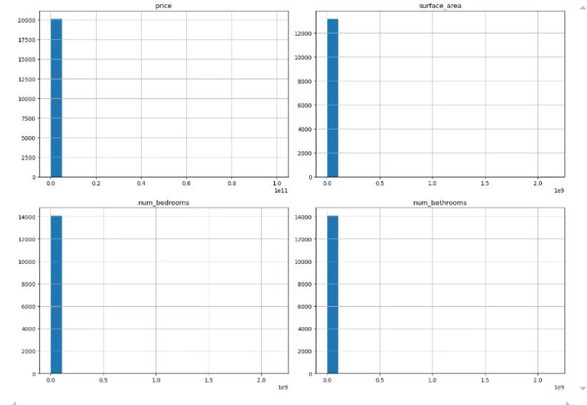
Exploratory Data Analysis (EDA)
Price Distribution by Category: Showed the skewness before transformation.
Plot histograms for relevant features in the dataset
Correlation Matrix: Showed the relationship between features like price, bedrooms, and bathrooms.

Slide 9
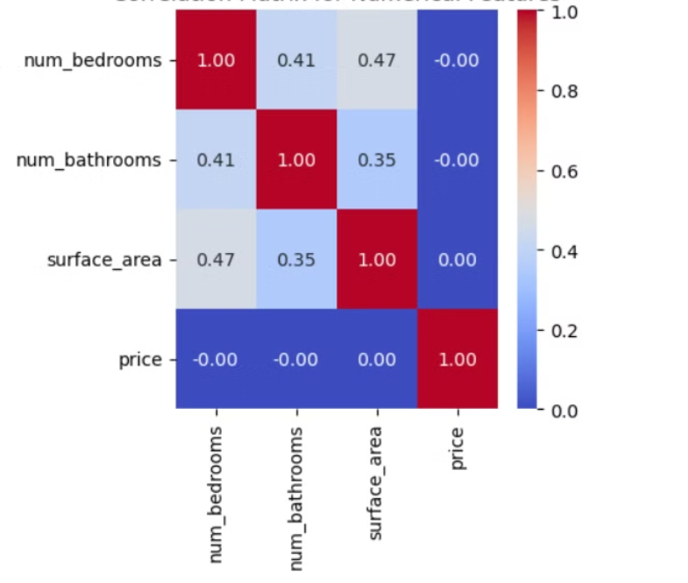
Exploratory Data Analysis (EDA)
Price Distribution by Category: Showed the skewness before transformation.
Plot histograms for relevant features in the dataset
Correlation Matrix: Showed the non-linear relationship between features .

Slide 10
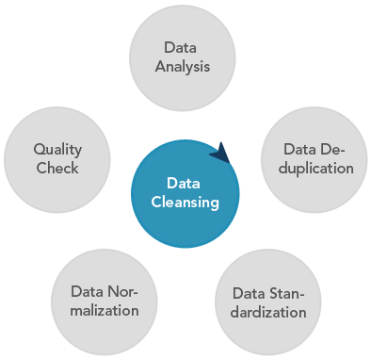
Data Cleaning Process
Dropped Irrelevant Columns: date columns .
Handled Missing Values: Removed rows with missing price (4 rows)
Corrected Price Anomalies:
Prices less than 10 were dropped.
Prices below 10,000 for properties "À Vendre" were multiplied by 1000.
Handling missing Data with each price range

Slide 11
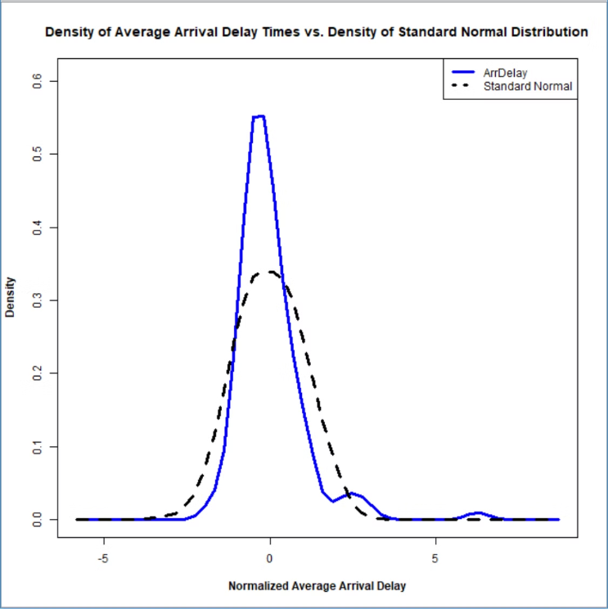
Data Cleaning Process
Outlier Handling :
Defined Reasonable numerical Ranges by Category:
Bedrooms: 1-4 for apartments, 1-20 for houses
Bathrooms: 1-3 for apartments, up to 15 for houses
Surface Area: Limited to reasonable ranges based on property type.
Log Transformation:
To handle skewness in the price, we applied a log transformation .

Slide 12



Feature Engineering:
Standardized Location: Split gouvernement into city and region and drop gouvernement
Converted categorical variables (category, transaction_type, city, region) into numeric form using one-hot encoding.
And Scaled Numerical Features
No strong Correlation between the Features which is good .

Slide 13


Processed and Cleaned Data
12586
295
rows
columns
Split the Data into 80 % Training and 20 % Testing

Slide 14



Modeling :
Gradient Boosting
1
An ensemble model that sequentially builds weak learners, combining them to create a strong predictor.
Random Forest
2
An ensemble model that combines multiple decision trees to improve prediction accuracy and reduce variance.
Decision Tree
3
A non-linear model that makes predictions based on a tree-like structure, dividing the data into smaller groups.

Slide 15
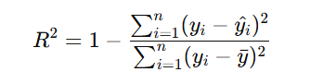
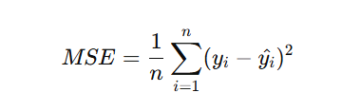
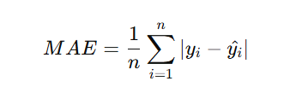
overall performance of the model and whether it's capturing the general trend in the data
a good metric when you want to minimize larger errors
less influenced by outliers
Model Evaluation:
comprehensive view of your model's performance

Slide 16

Model Performance:
Model
Mean Squared Error (MSE)
Mean Absolute Error (MAE)
R² Score
Decision Tree
0.42
0.36
0.7783
Random Forest
0.31
0.31
0.8368
Gradient Boosting
0.30
0.32
0.8433
Notes:
The r2 results are from cross-validation with 5 folds to ensure that the model generalized well.

Slide 17
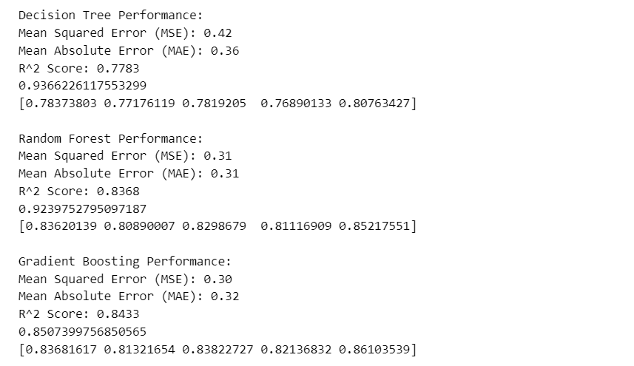

Slide 18

Model Deployment: Planning on Bringing
Predictions to Life
Model Prediction
Data Input
Our trained model processes the input and generates a price prediction.
Users input property details via an intuitive interface.
Web Application
Result Display
An interactive Flask web app provides instant predictions.
The predicted price is clearly presented to the user.

Slide 19

Thank you

